Slide 1
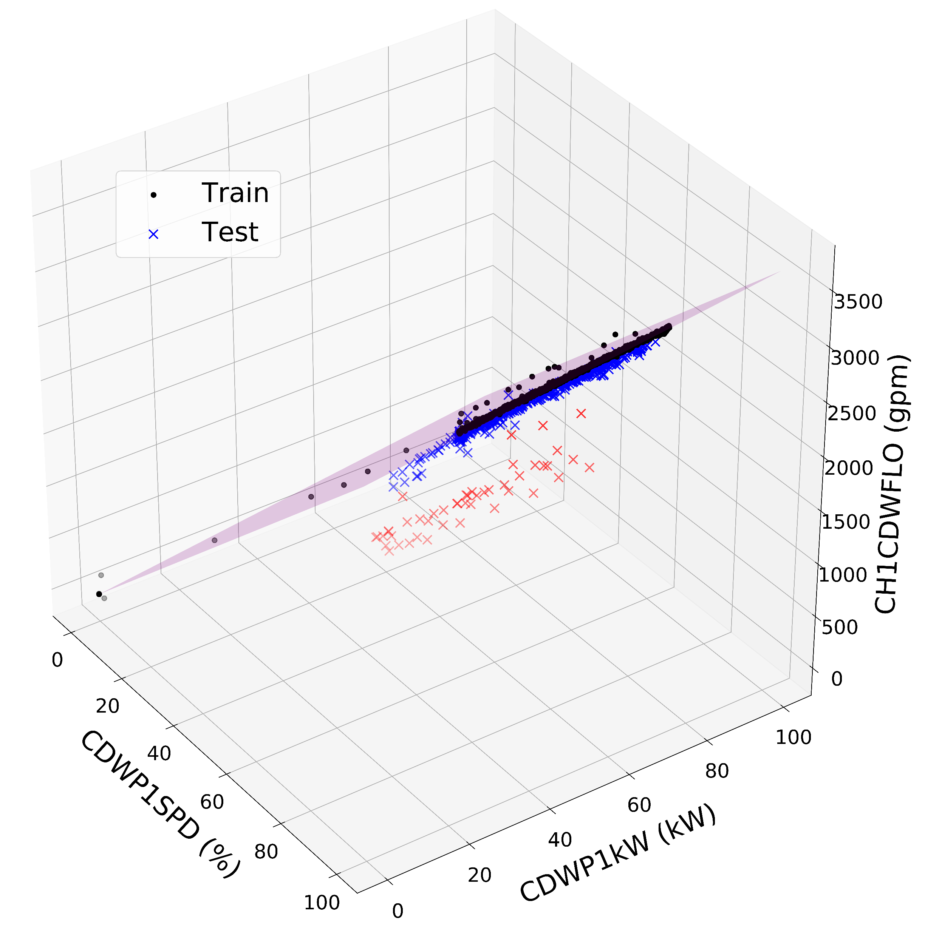
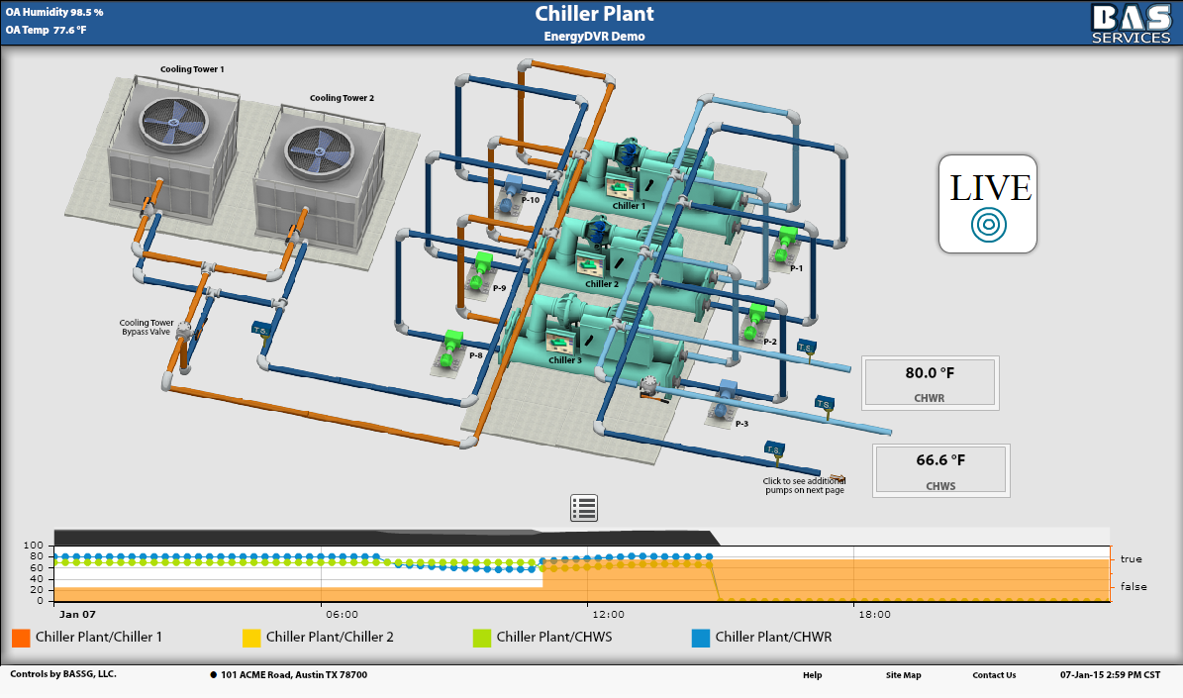
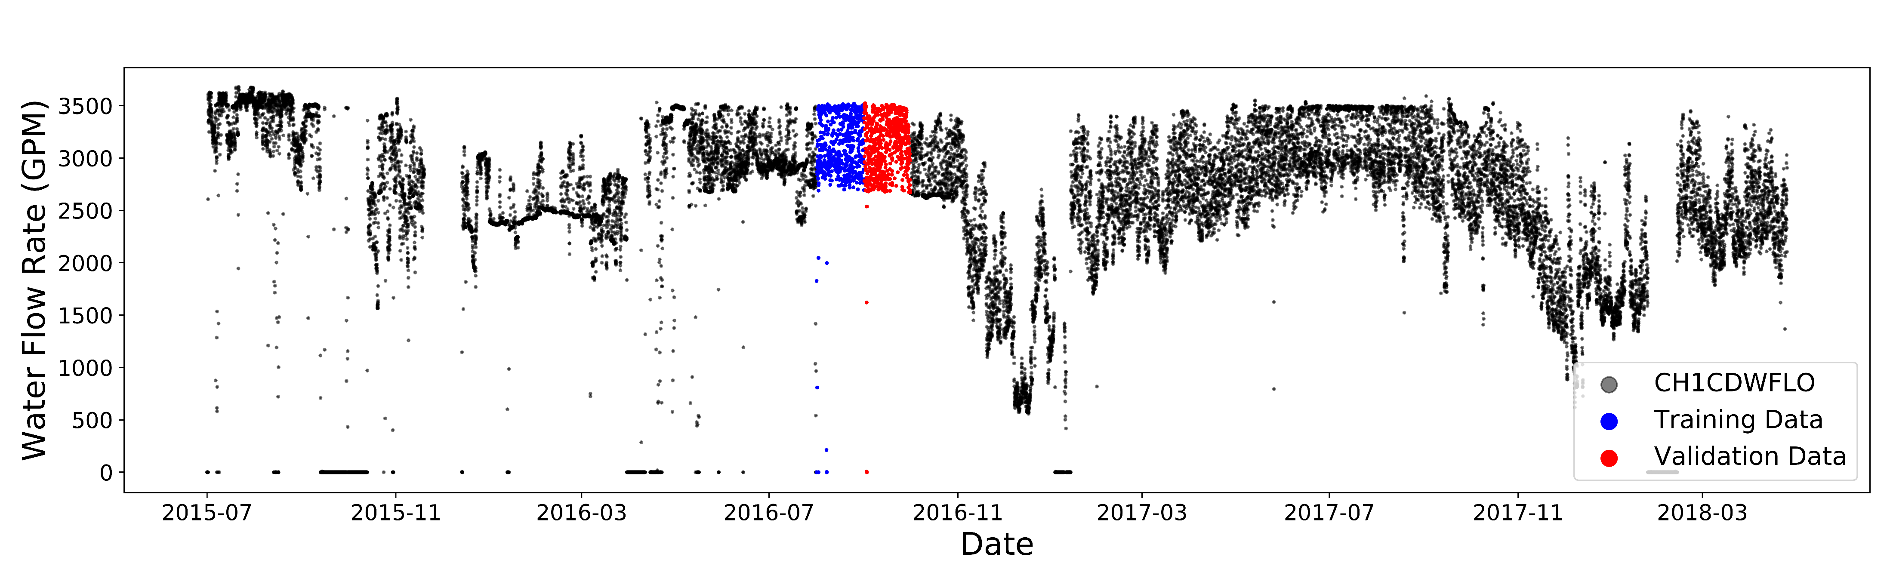
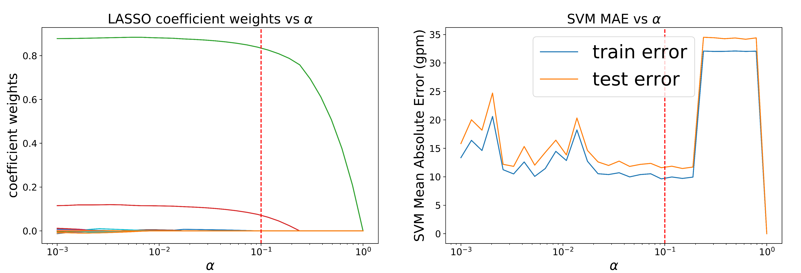
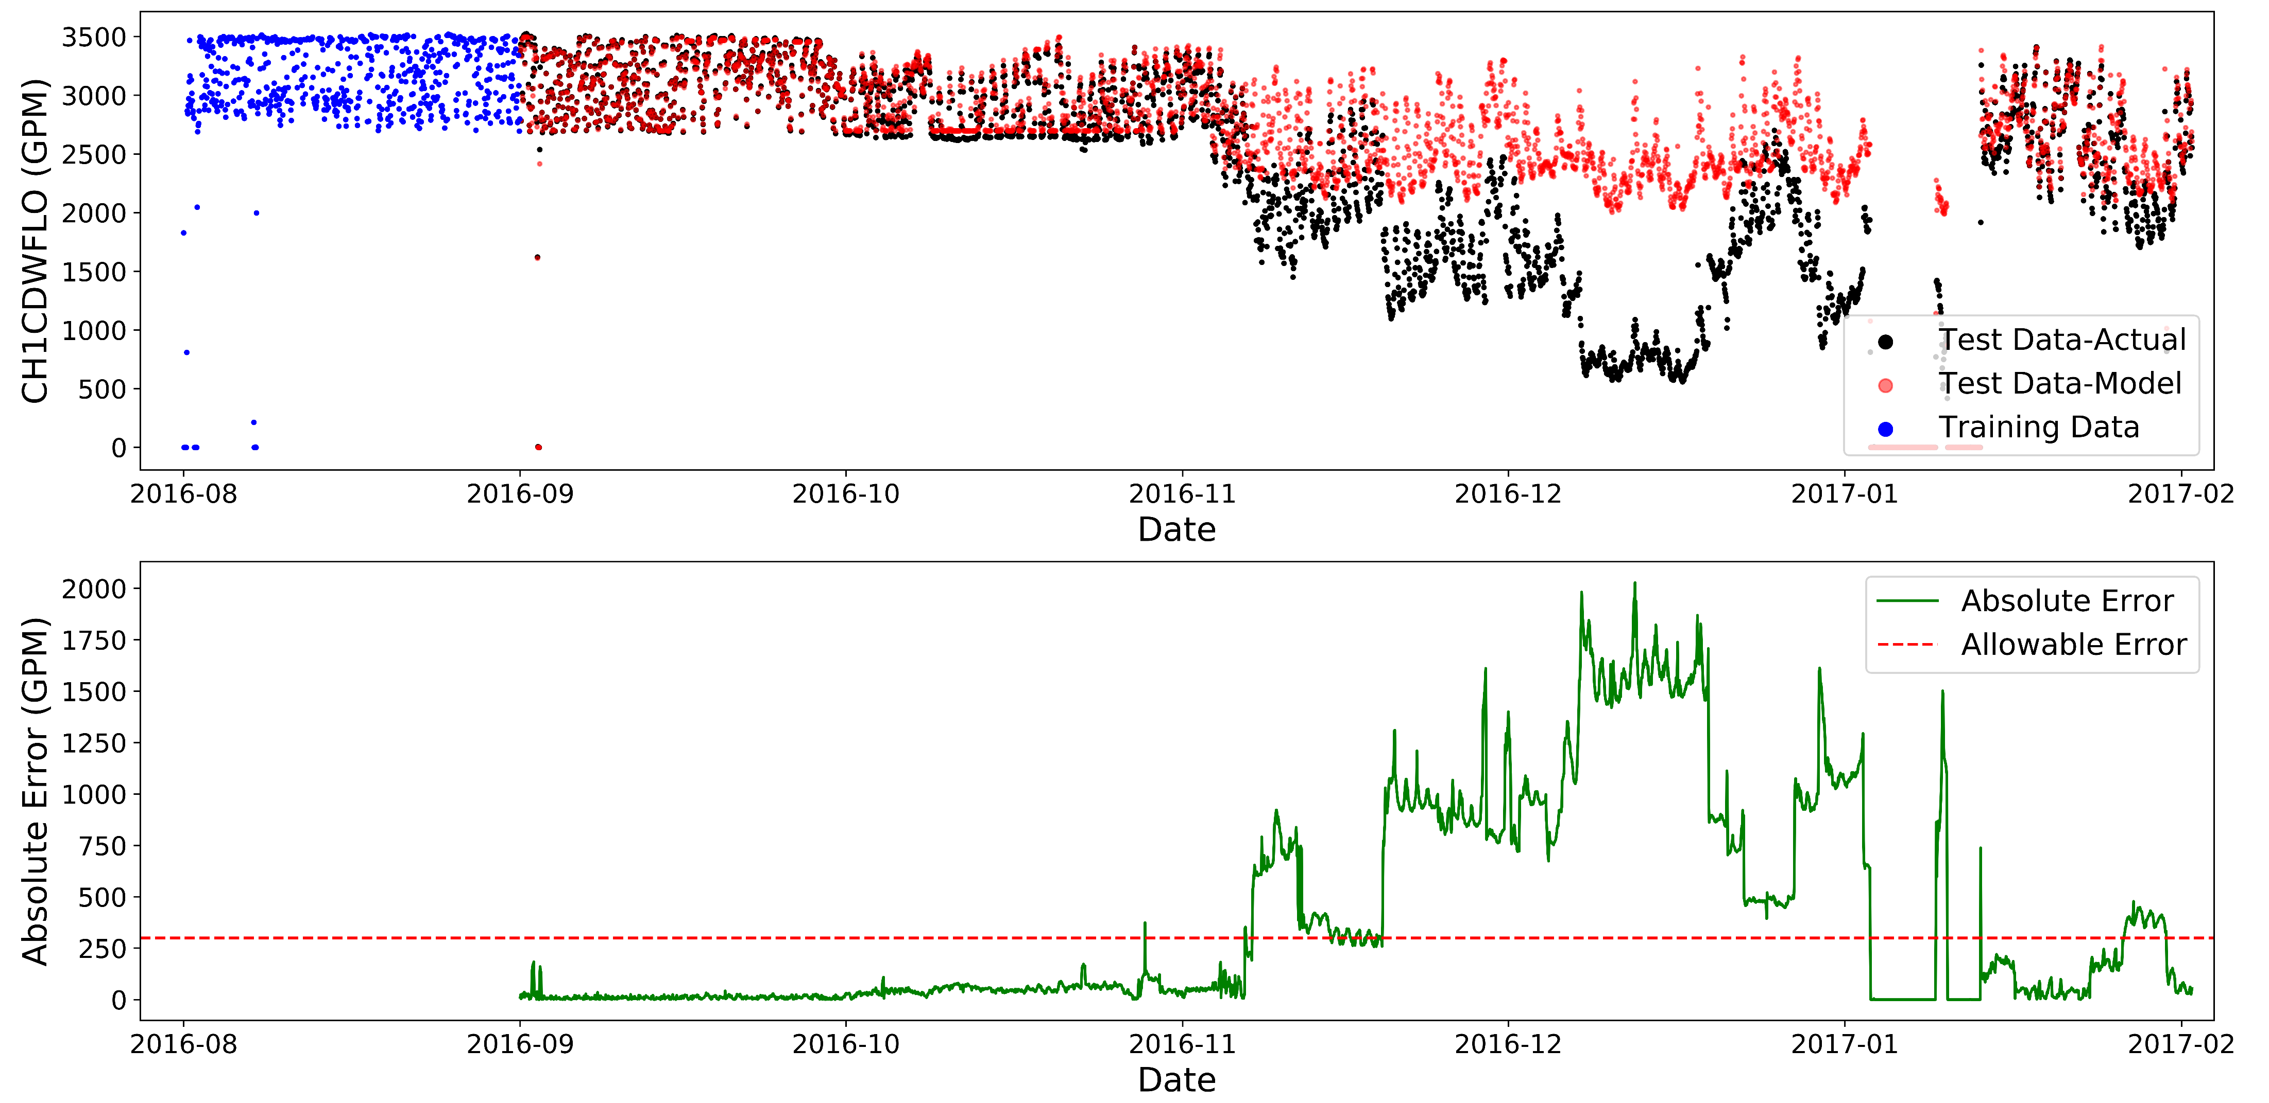






OPTIDRIFT: DETECTING SENSOR DRIFT OR FAILURE FOR CHILLER PLANT OPERATIONS
Victor W. Hu, Zihao Tau, Nicole L. Thompson
Sponsored by Optimum Energy LLC
Abstract
Using Support Vector Regression as our prediction model
In chiller plants, there are a multitude of sensors that have to be in calibration for safe, proper operation and optimized efficiency. Over time, these sensors can start to fail or slowly drift out of calibration, leading to inaccurate measurements and subsequent analyses for optimization. In this project sponsored by Optimum Energy LLC, we use a data-science approach to detect sensors that are either failing or drifting out of calibration. We are using support vector regression as our generalizable machine learning model that can predict any sensor’s output based off input from important surrounding sensors.
Months of Training Data | Mean Absolute Error (GPM)
1 mo. | 10 GPM
3 mos. | 24 GPM
6 mos. | 25 GPM
12 mos. | 31 GPM
Chiller Plants, Data, and Feature Set Reduction
Using one month of training data (blue) to predict the output for the following month. The model predictions (red) are accurate to the real plant data (black), with a mean absolute error of 10.31 GPM
Chiller plants can have hundreds of sensors and alarms that are constantly recorded. However, for our data science applications, it is important to know, for any given sensor, what physical parameters are necessary for predicting that sensor’s output.
3D representation of the support vector
regression hyperplane using a linear kernel
Determining out-of-calibration status
Statement about: Remember, goal is to apply this to test out of cal data
Generic chiller plant example
Sample dataset provided of flow-meter readings from an operational plant (black). A specific month’s data (blue) will be used to reduce the feature set and train the support-vector regression model. The model’s results will be compared with the subsequent month’s data (red).
Other Sensors
Future Work Goes Here
Future Work
Show results of applying training data to severely out of calibration data and how our model predictions can let them know that they’re sensors are drifting
LASSO is used for feature set reduction on the 200+ available features (left) and the corresponding mean absolute errors are shown (right) for each alpha. The errors are computed by taking the meaningful features at the alpha being tested and are then used in the support-vector regression model. The chosen alpha (vertical red line) is selected at a point where there is a meaningful feature set and small test error. For this chosen alpha, the meaningful features are CDWP1SPD and CDWP1kW

